Slide 1
Advanced Transaction Processing

Slide 2
Nested and Multilevel Transactions
A nested or multilevel transaction T is represented by a set
T = {t₁, t₂, ..., t_{n}} of subtransactions and a partial order P on T.
A subtransaction t_{i} in T may abort without forcing T to abort.
Instead, T may either restart t_{i}, or simply choose not to run t_{i}.
If t_{i} commits, this action does not make t_{i}, permanent. Instead, t_{i}, commits to T, and may still abort (or require compensation) if T aborts.
An execution of T must not violate the partial order P

Slide 3
Nested and Multilevel Transactions (Cont.)
Subtransactions can themselves be nested/multilevel transactions.
  Lowest level of nesting: standard read and write operations.
Nesting can create higher-level operations that may enhance concurrency.
Types of nested/ multilevel transactions:
  Multilevel transaction: subtransaction of T is permitted to release locks on completion.
  Saga: multilevel long-duration transaction.
  Nested transaction: locks held by a subtransaction t_{i} of T are automatically assign to T on completion of t_{i}.

Slide 4
Compensating Transactions
Alternative to undo operation; compensating transactions deal with the problem of cascading rollbacks.
Instead of undoing all changes made by the failed transaction, action is taken to “compensate” for the failure.
Consider a long-duration transaction T_{i} representing a travel reservation, with subtransactions T_{i,1}, which makes airline reservations, T_{i,2} which reserves rental cars, and T_{i,3} which reserves a hotel room.
  Hotel cancels the reservation.
  Instead of undoing all of T_{i}, the failure of T_{i},₃ is compensated for by deleting the old hotel reservation and making a new one.
  Requires use of semantics of the failed transaction.

Slide 5
Long Duration Transactions
Traditional concurrency control techniques do not work
well when user interaction is required:
Long duration: Design edit sessions are very long
Exposure of uncommitted data: E.g., partial update to a design
Subtasks: support partial rollback
Recoverability: on crash state should be restored even for yet-to-be committed data, so user work is not lost.
Performance: fast response time is essential so user time is not wasted.

Slide 6
Long-Duration Transactions
Represent as a nested transaction.
If transaction fails, only active short-duration transactions abort.
Active long-duration transactions resume once any short duration transactions have recovered.
The efficient management of long-duration waits, and the possibility of aborts.
Need alternatives to waits and aborts; alternative techniques must ensure correctness without requiring serializability.

Slide 7
Transaction Processing Monitors
TP monitors initially developed as multithreaded servers to support large numbers of terminals from a single process.
Provide infrastructure for building and administering complex transaction processing systems with a large number of clients and multiple servers.
Provide services such as:
  Presentation facilities to simplify creating user interfaces
  Persistent queuing of client requests and server responses
  Routing of client messages to servers
  Coordination of two-phase commit when transactions access multiple servers.
Some commercial TP monitors: CICS from IBM, Pathway from Tandem, Top End from NCR, and Encina from Transarc

Slide 8
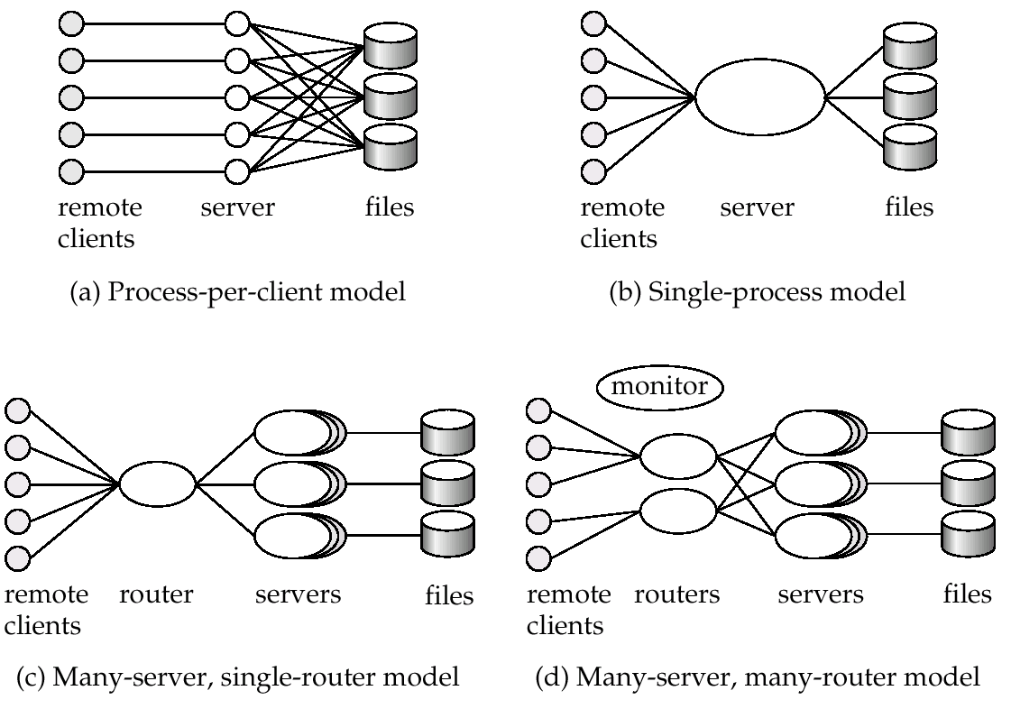
TP Monitor Architectures

Slide 9
TP Monitor Architectures (Cont.)
Process per client model - instead of individual login session per terminal, server process communicates with the terminal, handles authentication, and executes actions.
  Memory requirements are high
  Multitasking- high CPU overhead for context switching between processes
Single process model - all remote terminals connect to a single server process.
  Used in client-server environments
  Server process is multi-threaded; low cost for thread switching
  No protection between applications
  Not suited for parallel or distributed databases

Slide 10
TP Monitor Architectures (Cont.)
Many-server single-router model - multiple application server processes access a common database; clients communicate with the application through a single communication process that routes requests.
  Independent server processes for multiple applications
  Multithread server process
  Run on parallel or distributed database
Many server many-router model - multiple processes communicate with clients.
  Client communication processes interact with router processes that route their requests to the appropriate server.
  Controller process starts up and supervises other processes.

Slide 11
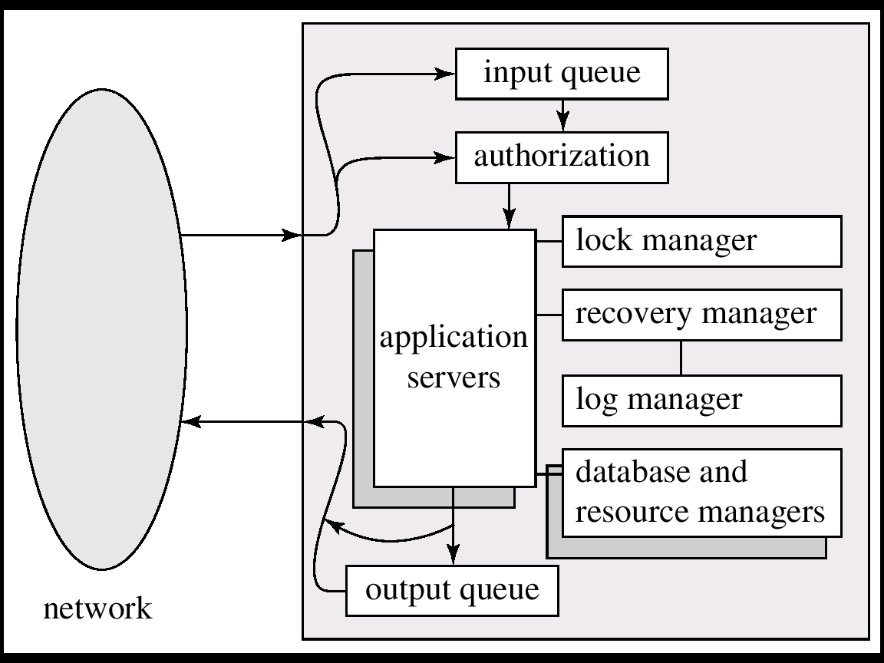
Detailed Structure of a TP Monitor

Slide 12
Detailed Structure of a TP Monitor
Queue manager handles incoming messages
Some queue managers provide persistent or durable message queueing contents of queue are safe even if systems fails.
Durable queueing of outgoing messages is important
  application server writes message to durable queue as part of a transaction
  once the transaction commits, the TP monitor guarantees message is eventually delevered, regardless of crashes.
  ACID properties are thus provided even for messages sent outside the database
Many TP monitors provide locking, logging and recovery services, to enable application servers to implement ACID properties by themselves.

Slide 13
Transactional Workflows
Workflows are activities that involve the coordinated execution of multiple tasks performed by different processing entities.
Workflows provide a convenient way of carrying out tasks that involve multiple systems.
Workflows usually involve humans: e.g. loan processing, or purchase order processing.

Slide 14
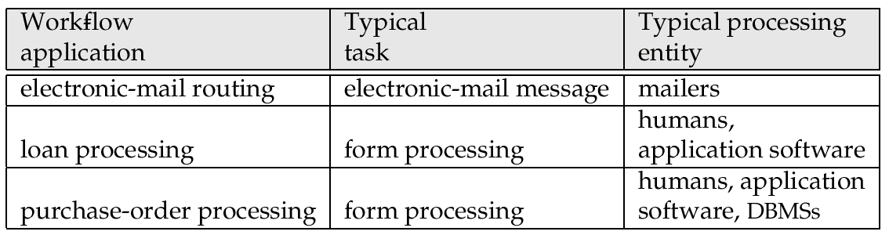
Examples of Workflows

Slide 15
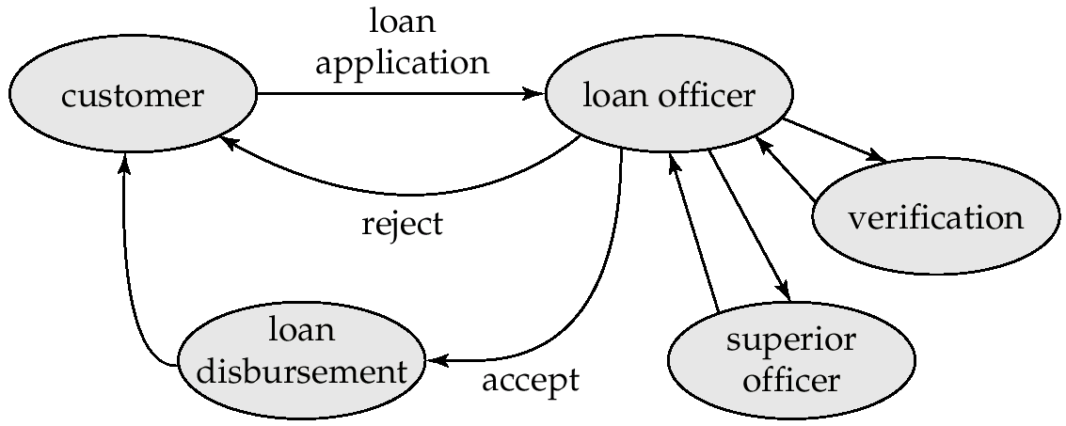
Loan Processing Workflow

Slide 16
Transactional Workflows
Must address following issues to computerize a workflow.
  Specification of workflows - detailing the tasks that must be carried out and defining the execution requirements.
  Execution of workflows - execute transactions specified in the workflow while also providing traditional database safeguards related to the correctness of computations, data integrity, and durability.
  E.g.: Loan application should not get lost even if system fails.
State of a workflow - consists of the collection of states of its constituent tasks, and the states (i.e. values) of all variables in the execution plan.

Slide 17
Workflow Specification
Static specification of task coordination:
  Tasks and dependencies among them are defined before the execution of the workflow starts.
  Can establish preconditions for execution of each task: tasks are executed only when their preconditions are satisfied.
  Defined preconditions through dependencies:
    Execution states of other tasks.
“task t_{i} cannot start until task t_{j} has ended”
    Output values of other tasks.
  “task t_{i} can start if task t_{j} returns a value greater than 25”
    External variables, that are modified by external events.
“task t_{i} must be started within 24 hours of the completion of task t_{j}”

Slide 18
Execution of Workflows
Workflow management systems include:
Scheduler - program that process workflows by submitting various tasks for execution, monitoring various events, and evaluation conditions related to intertask dependencies
Task agents - control the execution of a task by a processing entity.
Mechanism to query to state of the workflow system.

Slide 19
Workflow Management System Architectures
Centralized - a single scheduler schedules the tasks for all concurrently executing workflows.
  used in workflow systems where the data is stored in a central database.
  easier to keep track of the state of a workflow.
Partially distributed - has one (instance of a ) scheduler for each workflow.
Fully distributed - has no scheduler, but the task agents coordinate their execution by communicating with each other to satisfy task dependencies and other workflow execution requirements.
  used in simplest workflow execution systems
  based on electronic mail

Slide 20
Failure-Automicity Requirements
Usual ACID transactional requirements are too strong/unimplementable for workflow applications.
However, workflows must satisfy some limited transactional properties that guarantee a process is not left in an inconsistent state.
Acceptable termination states - every execution of a workflow will terminate in a state that satisfies the failure-atomicity requirements defined by the designer.
  Committed - objectives of a workflow have been achieved.
  Aborted - valid termination state in which a workflow has failed to achieve its objectives.
A workflow must reach an acceptable termination state even in the presence of system failures.

Slide 21
Real-Time Transaction Systems
In systems with real-time constraints, correctness of execution involves both database consistency and the satisfaction of deadlines.
  Hard deadline – Serious problems may occur if task is not completed within deadline
  Firm deadline - The task has zero value if it completed after the deadline.
  Soft deadline - The task has diminishing value if it is completed after the deadline.
The wide variance of execution times for read and write operations on disks complicates the transaction management problem for time-constrained systems
  main-memory databases are thus often used
  Waits for locks, transaction aborts, contention for resources remain as problems even if data is in main memory
Design of a real-time system involves ensuring that enough processing power exists to meet deadline without requiring excessive hardware resources.

Slide 22
Weaker Consistency
Transaction management is complicated in multidatabase systems because of the assumption of autonomy
Due to autonomy requirements, sites cannot cooperate and execute a common concurrency control scheme
Solutions:
  provide very low level of concurrent execution, or
  use weaker levels of consistency
Use alternative notions of consistency that do not ensure serializability, to improve performance.
Degree-two consistency avoids cascading aborts without necessarily ensuring serializability.
  Unlike two-phase locking, S-locks may be released/acquired at any time.
  X-locks be released until the transaction either commits or aborts.

Slide 23
Example Schedule with Degree-Two Consistency
Nonserializable schedule with degree-two consistency (Figure 20.5) where T₃ reads the value if Q before and after that value is written by T_{4.}
T₃
T₄
lock-S (Q)
read (Q)
unlock (Q)
lock-X (Q)
read (Q)
write (Q)
unlock (Q)
lock-S (Q)
read (Q)
unlock (Q)

Slide 24
Cursor Stability
Form of degree-two consistency designed for programs written in general-purpose.
Rather than locking the entire relation, cursor stability ensures that
  The tuple that is currently being processed by the iteration is locked in shared mode.
  Any modified tuples are locked in exclusive mode until the transaction commits

